Slide 1
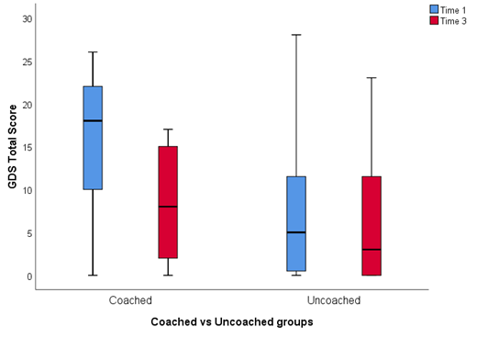
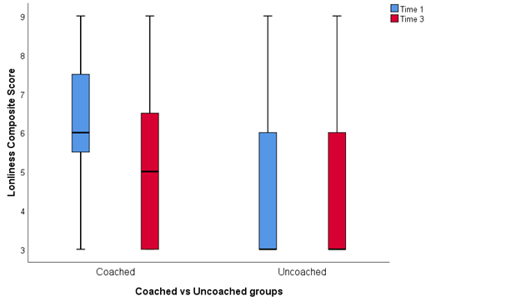
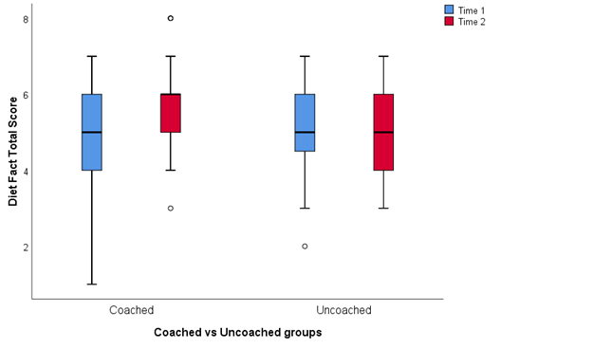
Steps to Better Health: Efficacy of Culturally and Lingually Appropriate Personalized Health Coaching for Immigrants
Presenters: Robyn Husa¹, Dhvanii Raval², Julia Ostropolsky³, Kimberly Osmnagic³, Lisa Willoughby¹, & Hisako Matsuo⁴
1. Department of Psychology SLU, 2. Undergraduate Neuroscience Program SLU, 3. Bilingual International Assistant Services, 4. Department of Sociology and Anthropology
BACKGROUND
Immigration to the Saint Louis Area
The Census Bureau estimates that the number of foreign-born Missouri residents nearly tripled between 1990 and 2016 with more than a third (about 89,000) residing in St. Louis city and St. Louis County.
The Census Bureau also estimates that nearly 41% of the St. Louis-area foreign-born adults speak English “less than very well.” Further, 17% have less than a high school education (compared to just 10% of local native adults).
Health Barriers for Immigrants
A preliminary assessment by Saint Louis University, Washington University, and Barnes Jewish Hospital found mental health concerns among most groups due to isolation and poor knowledge of American culture, and post-traumatic stress among a large population of Bosnian war refugees. Similar concerns have been voiced by representatives of Family Care Health Centers, a local federally qualified health center.
Language barriers, poor understanding of America’s medical system and cultural variations were cited as major obstacles among immigrants.
Efficacy of Health Coaching
The Steps to Better Health for Immigrants and Refugees project (SBH-IR) aimed to address the special needs in the immigrant population through health coaches who are familiar with immigrants’ languages and cultures in order to facilitate changes in health behaviors that have proven challenging to immigrants.
Immigrant-specific data are sparse, but a study of Chinese Americans with diabetes showed that with culturally and linguistically appropriate coaching, 45.7% of participants had well-controlled A1c levels, much better than the 23.9% in a non-intervention group.¹
Our design was influenced by an integrative review of 15 studies.² Coaching was most frequently effective in improving the areas of nutrition, physical activity, weight management and medication adherence. Common features of effective programs were goal setting, motivational interviewing, and health care provider collaboration.
METHODS AND EXPERIMENTAL DESIGN, CONT.
Procedures
During first six months of project, 30 participants made personalized health plans and received weekly coaching. At the same time, 30 other participants received only generalized health and social service information and no coaching. Both groups were assessed at baseline, 3 and 6 months for changes and differences in health and health behaviors.
In the second half of the project year, the uncoached group developed individualized health plans and received the same coaching and progress tracking as the first group. This process repeated in Year 2 to serve at least 120 participants over the project’s course.
Individuals in the uncoached group were slightly younger than those in the coached group (Coached Mean = 60.06, SD = 15.185, Uncoached Mean = 56.06 SD=17.817).
RESULTS
Objective 1: Compliance
Flu shot: 60% of all participants had received one flu shot at baseline (67% coached, 59% uncoached). There were only 2 additional individuals who received a flu shot by 6 months and they were in the uncoached group.
PCP visits: 15% (19/127) had not visited their primary care physician in the past year (17% coached, 13% uncoached). By time 3, that number decreased to 13% overall (14% coached , 11% uncoached).
Taking medications on time: 84% of participants were compliant at baseline. However at Time 3, that number increased substantially (97%) and was 100% for the coached individuals and 95% for the uncoached individuals.
Objective 2: Mental Health
Coached participants with baseline depression symptoms showed significantly greater improvement in depression symptoms (M = 2.92 improvement, SD = 1.68) on the PHQ4 compared to uncoached participants (M = 0.71, SD = 1.11). They also showed improvement on the GDS(M = 9 points improvement, SD = 5.93) compared to uncoached participants (M = 3.10, SD = 4.70).
The coached group significantly decreased in feelings of loneliness (M = 5.8333, SD = 1.94906) compared to the uncoached group at the 6 month (M =4.6047, SD = 2.04869).
Objective 3: Physical Activities
Uncoached group showed higher values in walking minutes and moderate activities at baseline compared to coached group.
At 6 months, 56% of participants showed improvement in moderate activities, 19% in vigorous activities, and 45% in sitting time.
Objective 4: Better Diet
At baseline, the coached individuals had statistically lower baseline dietary behavior scores than the uncoached individuals. However, there were no statistical differences between the two groups in dietary knowledge.
The general pattern at 6 months suggested improvements in both indicators. Out of 112 participants, 64 (57%) had increased health knowledge scores and 82 (72%) had increased health behavior scores.
Positive change in health behaviors were clearly driven by the 98% of the coached individuals who showed improvement, compared with the 47% in the uncoached group who showed improvement. Health knowledge scores also showed greater improvements among the coached individuals (61% improved) compared to uncoached individuals (53% improved).
Demographic Characteristics
 | Coached (67) | Uncoached (65)
Gender
Male | 22 | 19
Female | 43 | 43
Marital Status
Single | 12 | 5
Divorced | 48 | 53
Widowed | 4 | 3
Other | 0 | 1
Entry Mode to US
Immigrant | 25 | 28
Refugee | 35 | 33
Prefer not to answer | 4 | 1
Speak English
No | 62 | 58
Yes | 1 | 4
Note: Each category does not add up to total sample size due to missing data.
METHODS AND EXPERIMENTAL DESIGN
The heart of the SBH-IR project is development of a personalized health plan and weekly health coaching to help immigrants follow their plan.
The coaching process began with a baseline evaluation of each participant’s diet and exercise habits, functional activity, general physical and mental health, and health care access. Staff from SLU’s Health Policy Research Lab trained six bilingual BIAS coaches to carefully interview participants to identify gaps in health knowledge and behaviors.
After each weekly session, they recorded data relevant to each individual’s health plan with Efforts to Outcomes software.
Objectives
Prevention/Compliance - 90% of participants whose health plan includes a screening, preventive action, or adherence to a prescribed regimen will demonstrate evidence of compliance within 6 months.
Mental Health - 75% of participants with depressive symptoms at baseline will improve their scores on the Center for Epidemiological Studies Depression Scale (CES-D), within 6 months.
Physical Activities - 90% of participants will increase weekly physical activity from baseline, as measured by the International Physical Activity Questionnaire (IPAQ), within 6 months.
Better Diet - 30% of participants will eat healthier, as shown by a modified version of the Diet History Questionnaire, within 6 months.
CONCLUSIONS
Health coaching contributes to reducing intrinsic cultural/lingual barriers immigrants face in healthcare.
Some measures had more efficacy than others.
Over a 6-months period, the intervention group showed significant improvement in depression symptoms as compared to the control group. The target improvement of 75% was exceeded. This demonstrates the positive impact and efficacy of mental health coaching to immigrants.
The target of 90% improvement in physical exercise was not met, though there were increases in physical activity over the timeframe. Many participants are in the labor force, so it was difficult to reduce sitting.
There were statistically significant increases in health knowledge and behaviors for both groups together. When considered separately, this pattern held only for the intervention group. Thus, health behaviors can be improved via coaching.
Future plans include potentially expanding this project beyond immigration status. We hope to expand a part of this project to positively impact social policy by collaborating with Department of Health and Human Services of St. Louis Country and City of St. Louis.
CITATIONS
Ivey, S., Tseng, W., Kurtovich, E. … & Hubbard, A. (2012). Evaluating a culturally and linguistically competent health coach intervention for Chinese-American patients with diabetes. Diabetes Spectrum, 25(2), 93-102.
Olsen, J. M., & Nesbitt, B. J. (2010). Health coaching to improve healthy lifestyle behaviors: an integrative review. American Journal of Health Promotion , 25(1), e1-e12.
ACKNOWLEDGEMENTS
This project was funded by Missouri Foundation for Health. We thank the participants in this projects and health coaches at Bilingual International Assistant Services.
Notes:
Students interested in applying for an internship or volunteering to be a health coach to serve immigrant community should contact Hisako.matsuo@slu.edu.
NEXT STEPS: SLU and BIAS teams received funding from Lutheran Foundation to expand STEPS program for sustainability. We will launch a new program, called Culturally Appropriate Transformation to Culture of Health (CATCH) program staring July 2019.
Loneliness composite: “How often do you feel you lack companionship?”, “How often do you feel isolated from others?”, “How often do you feel left out?”

